Slide 1
CST204 Database Management System
Module 2

Slide 2
Introduction
Syllabus – Overview
Module 1 : Introduction and Entity Relationship (ER) model
Module 2 : Relational Model
Module 3 : SQL DML and Physical Data Organization
Module 4 : Normalization
Module 5: Transaction, concurrency and recovery, recent topics

Slide 3
Introduction
Syllabus – Module 2
Structure of Relational Databases
Integrity Constraints
Synthesizing ER diagram to relational schema
Introduction to Relational Algebra
Select, project, cartesian product operations, join - Equi-join, natural join, query examples
Introduction to Structured Query Language (SQL), Data Definition Language (DDL), Table definitions and operations – CREATE, DROP, ALTER, INSERT, DELETE, UPDATE

Slide 4
Relational Data Model
Relation Data Model
Based on the concept of Relation
It is a mathematical concept based on the ideas of sets
Strength of the relational approach is the formal foundation provided by the theory of relations
Model was first proposed by Dr. E F Codd of IBM in 1970

Slide 5
Relational Data Model
Relation Data Model
Based on the concept of Relation
It is a mathematical concept based on the ideas of sets
Strength of the relational approach is the formal foundation provided by the theory of relations
Model was first proposed by Dr. E F Codd of IBM in 1970

Slide 6
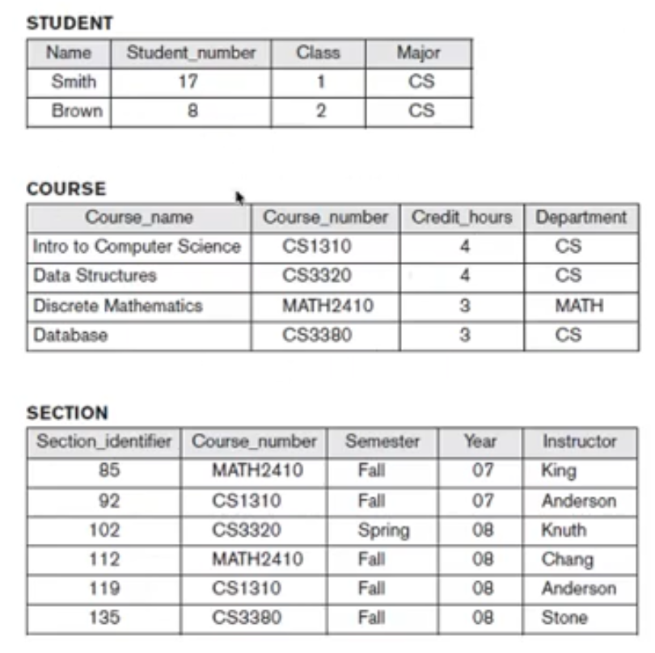
Relational Data Model
Relation Data Model

Slide 7
Relational Data Model
Relation – Informal Definition
Relation is defined as a table of values
Relation is a set of rows
Relation is a set of columns
Relation is a set of rows in which each row represents an entity or relationship
Relation is a set of rows in which each row has a value of an item or set of items that uniquely identifies that row in the table
Sometimes row ids or sequential numbers are assigned to identify the rows in the table
Each column typically is called by its column name or column header or attribute name

Slide 8
Relational Data Model
Relation – Formal Definition
Schema of a Relation, R(A₁, A₂, …., A_{n})
Relation schema R is defined over attributes A₁, A₂,…., A_{n}
D is called the domain of A_{i} and is denoted by dom(A_{i})
R is called the name of this relation
Degree (or arity) of a relation is the number of attributes n of its relation schema
For example
STUDENT(Name, Roll_number, Home_Phone, Address, Age, CGPA)
STUDENT(Name: string, Roll_number: integer, Home_Phone: integer, Address: string, Age: integer, CGPA: real)

Slide 9
Relational Data Model
Relation – Formal Definition
Tuple is an ordered set of values (informally called as rows in a table)
CUSTOMER(Cust_id, Cust_name, Address, Phone_number)
<632895, “John Smith”, “101 Main St. Atlanta, GA 30332”, “9993434394”>
A relation may be regarded as set of tuples (rows)
Columns in a table are also called attributes of the relation

Slide 10
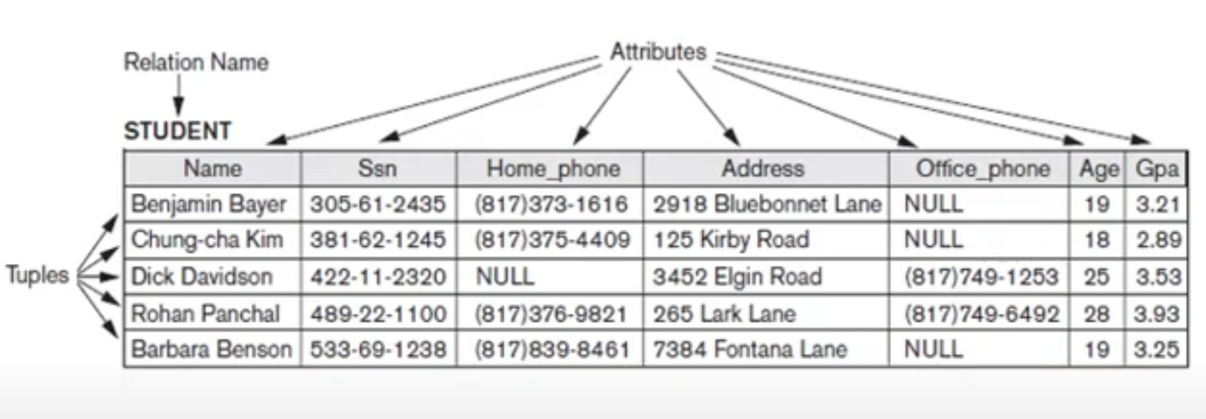
Relational Data Model
Relation – Formal Definition

Slide 11
Relational Data Model
Relation – Formal Definition
Domain is the pool of values from which a particular value is taken
For example, mobile numbers are the set of 10 digit numbers taken from a domain
Domain may have a data type or a format defined for it
Relation state r of the relation schema R(A₁, A₂, …, A_{n}), also denoted by r(R), is a set of n tuples r = {t₁, t₂,….., t_{n}}
Each tuple t is an ordered list of n values t = v₁, v₂, …, v_{n}, where each value vi, 1 <= i <= n, is an element of dom(A_{i}) or is a special NULL value

Slide 12
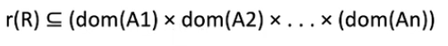
Relational Data Model
Relation – Formal Definition
A relation state r(R) is a mathematical relation of degree n
R is called schema of the relation
r(R) is a specific value or population of R
R is also called the intension of a relation
r is also called the extension of a relation

Slide 13
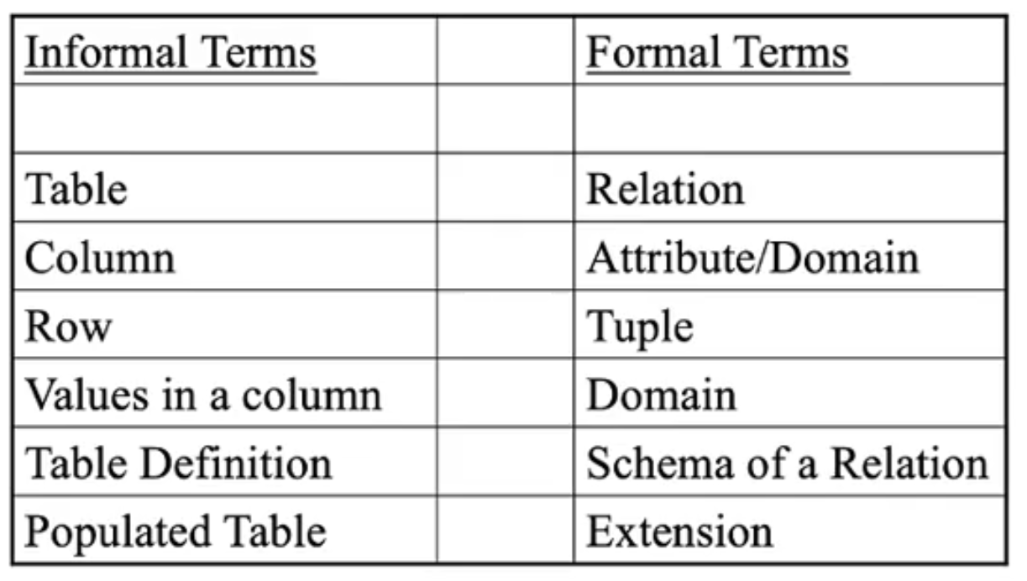
Relational Data Model
Relation – Definition Summary

Slide 14
Relational Data Model
Characteristics of Relations
Ordering of tuples in a relation
Tuples are not considered to be ordered
Ordering of attributes in a relation schema R
We will consider the attributes in R(A₁, A₂, …A_{n}) and the values in t = <v₁, v₂,…v_{n}> to be ordered
Values in a tuple
All values are considered atomic (indivisible)
A special null value is used to represent values that are unknown or inapplicable to certain tuples

Slide 15
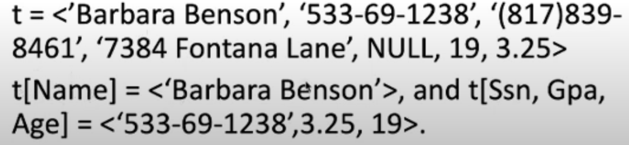
Relational Data Model
Relational Model Notation
A relation schema R of degree n is denoted by R(A₁, A₂,…A_{n})
Uppercase letters Q, P, R, S denotes relation names
Lowercase letters q, p, r, s denotes relation states
Letters t, u, v denote tuples

Slide 16
Relational Data Model
Relational Integrity Constraints
Constraints are conditions that must hold on all valid relation instances
Different types of constraints used in relational model are
Inherent model-based constraints or implicit constraints
Constraints inherent in the data model
Schema based constraints or explicit constraints
Specified using DDL commands
Application based or semantic constraints or business rules
Specified using application program

Slide 17
Relational Data Model
Relational Integrity Constraints
Our focus is on Inherent model based constraints which consists of:
Key constraints
Entity Integrity constraints
Referential Integrity constraints

Slide 18
Relational Data Model
Inherent model based constraints - Key constraints
A key in DBMS is an attribute or a set of attributes that help to uniquely identify a tuple (or row) in a relation (or table)
Keys are also used to establish relationships between the different tables and columns of a relational database
Individual values in a key are called key values
There are mainly four types of keys in DBMS:
Primary Key
Candidate Key
Super Key
Foreign Key

Slide 19
Relational Data Model
Inherent model based constraints - Key constraints
Primary Key
A primary key is a column of a table or a set of columns that helps to identify every record present in that table uniquely
There can be only one primary Key in a table
Also, the primary Key cannot have the same values repeating for any row
Every value of the primary key has to be different with no repetitions
Super Key
Super Key is the set of all the keys which help to identify rows in a table uniquely
This means that all those columns of a table than capable of identifying the other columns of that table uniquely will all be considered super keys

Slide 20
Relational Data Model
Inherent model based constraints - Key constraints
Candidate Key
Candidate keys are those attributes that qualifies to be a primary key
The Primary Key of a table is selected from one of the candidate keys
So, candidate keys have the same properties as the primary keys

Slide 21
Relational Data Model
Inherent model based constraints – Entity integrity constraints
Relational Database Schema
A set S of relation schemas that belong to the same database
S is the name of the database
S = {R₁, R₂, …., R_{n}}
Entity Integrity
Primary key attribute PK of each relation schema R in S cannot have null values in any tuple of r
t[PK] not equal to null for any tuple t in r(R)

Slide 22
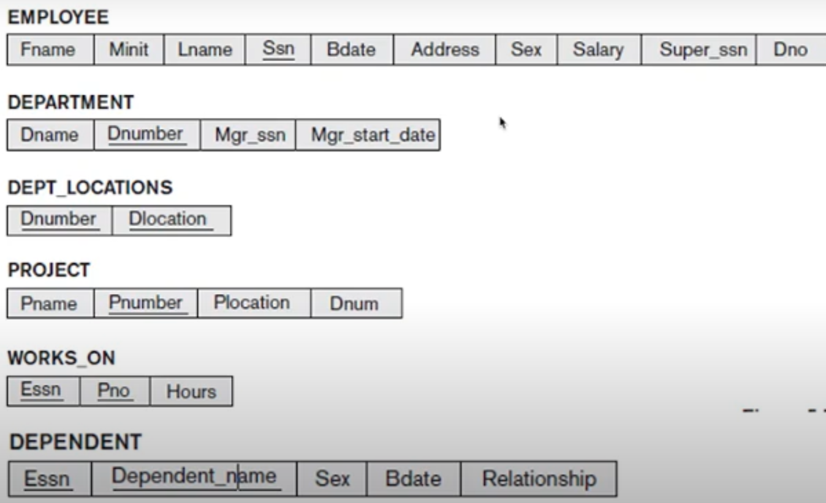
Relational Data Model
Inherent model based constraints – Entity integrity constraints

Slide 23
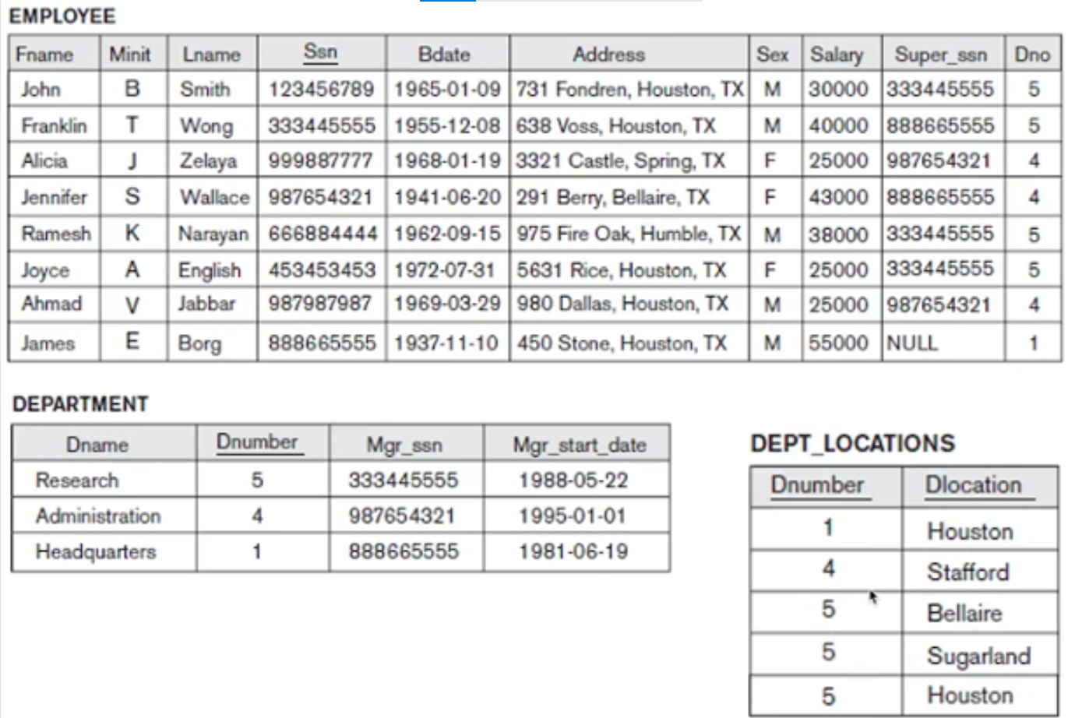
Relational Data Model
Inherent model based constraints – Entity integrity constraints

Slide 24
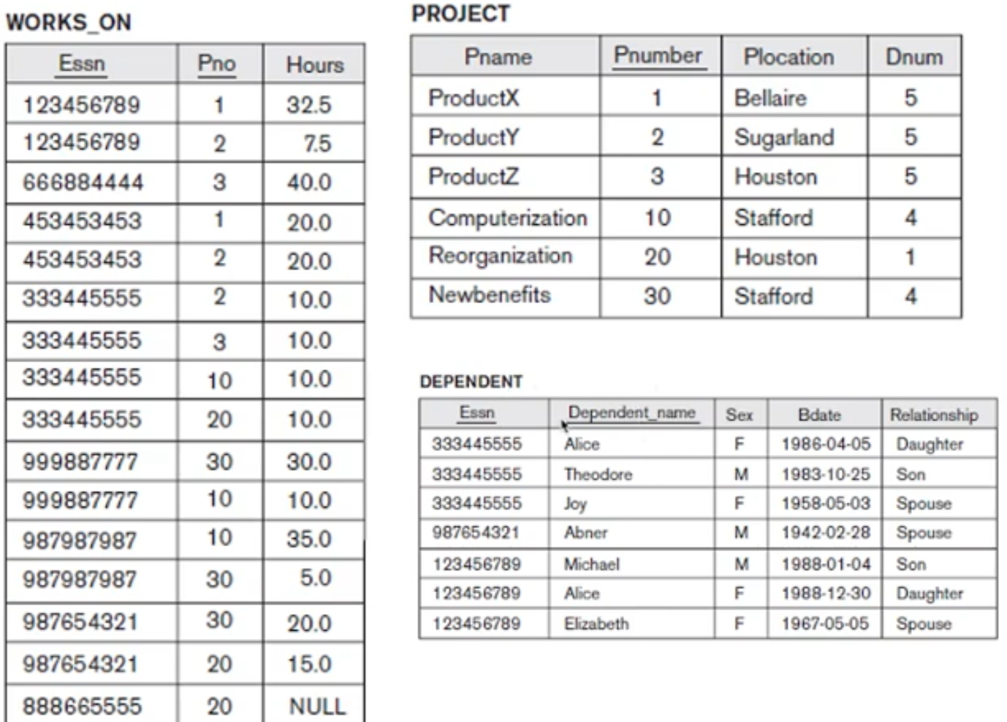
Relational Data Model
Inherent model based constraints – Entity integrity constraints

Slide 25
Relational Data Model
Inherent model based constraints Referential integrity constraints
It is the constraints involving two relations
Used to specify a relationship among tuples in two relations – the referencing relation and the referenced relation
Tuples in the referencing relation R1 attributes Foreign Key (FK) that reference the primary key attributes PK of the referenced relation R2
Foreign Key is used to establish relationships between two tables
A foreign key will require each value in a column or set of columns to match the Primary Key of the referential table
Foreign keys help to maintain data and referential integrity

Slide 26
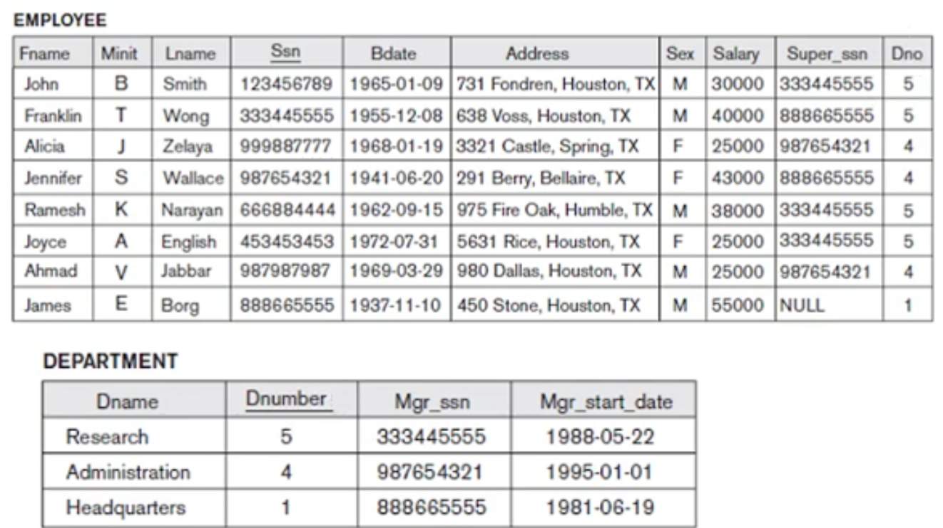
Relational Data Model
Inherent model based constraints Referential integrity constraints

Slide 27
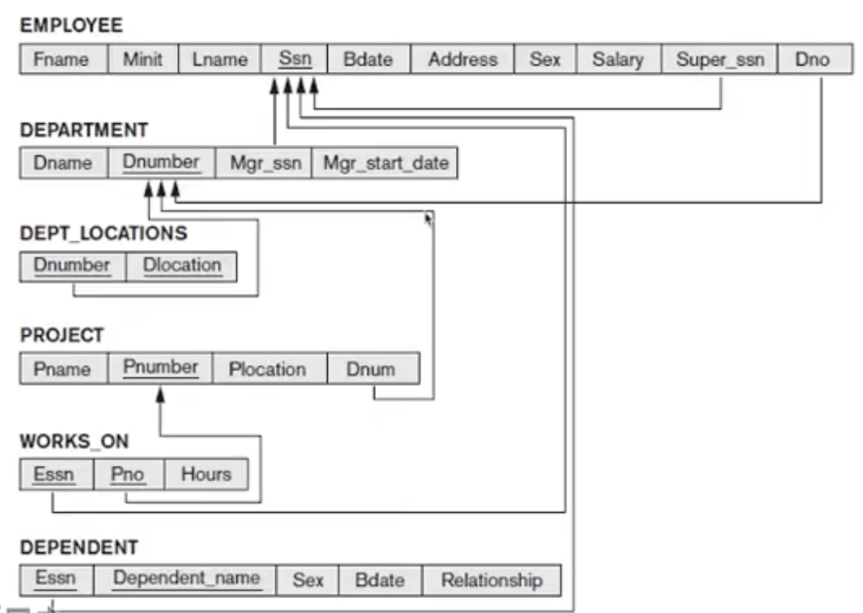
Relational Data Model
Inherent model based constraints Referential integrity constraints

Slide 28
Relational Data Model
Synthesizing ER Diagram to Relational Model
Step 1: Mapping of regular entity types
Step 2: Mapping of weak entity types
Step 3: Mapping of binary 1:1 relation types
Step 4: Mapping of binary 1:N relationship types
Step 5: Mapping of Binary M:N relationship types
Step 6: Mapping of multivalued attributes
Step 7: Mapping of N-ary relationship types

Slide 29
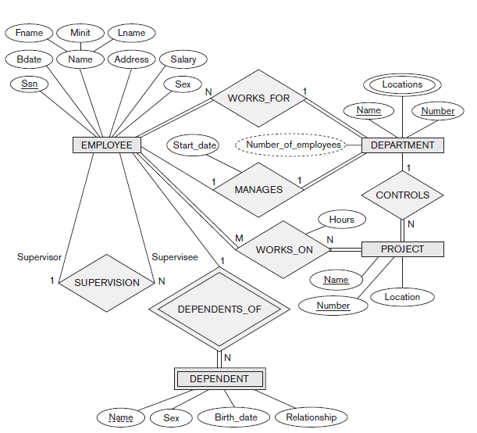
Relational Data Model
Synthesizing ER Diagram to Relational Model

Slide 30
Relational Data Model
Synthesizing ER Diagram to Relational Model

Slide 31
Relational Data Model
Synthesizing ER Diagram to Relational Model
Step 1: Mapping of regular entity types
For each regular (strong) entity type E in the ER schema, create a relation R that includes all the simple attributes of E
Choose one of the key attributes of E as the primary key for R
If the chosen key of E is composite, the set of simple attributes that form it will together form the primary key of R

Slide 32
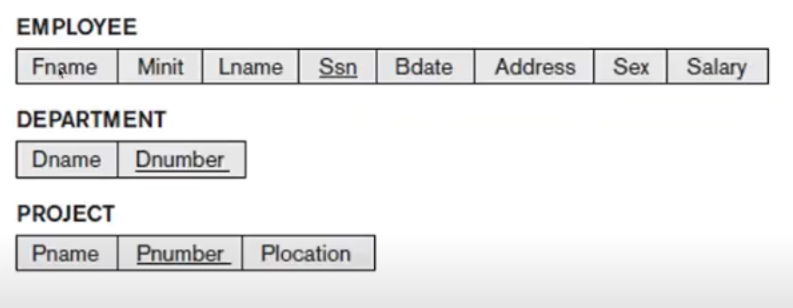
Relational Data Model
Synthesizing ER Diagram to Relational Model
Step 1: Mapping of regular entity types
After Step 1

Slide 33
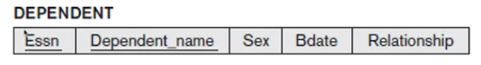
Relational Data Model
Synthesizing ER Diagram to Relational Model
Step 2: Mapping of weak entity types
For each weak entity type W with owner entity type E, create a relation R and include all simple attributes of W as attributes of R
In addition, include as foreign key attributes of R the primary key attribute of the relations that corresponds to the owner entity type
Primary key of R is the combination of the primary keys of the owner and the partial key of the weak entity type W if any
After step 2

Slide 34
Relational Data Model
Synthesizing ER Diagram to Relational Model
Step 3: Mapping of binary 1:1 relation types
For each binary 1:1 relationship type R in the ER schema, identify the relations S and T that corresponds to the entity types participating in R
Three possible approaches
Foreign key approach
Choose one of the relations as S
Include a foreign key in S the primary key of T
It is better to choose an entity type with total participation in R in the role of S

Slide 35
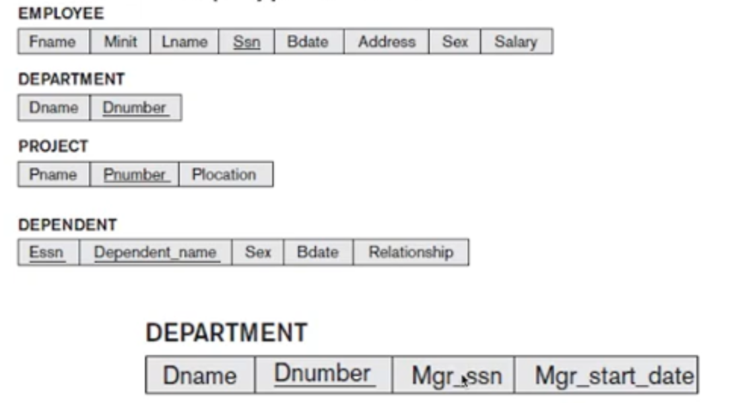
Relational Data Model
Synthesizing ER Diagram to Relational Model
Step 3: Mapping of binary 1:1 relation types
1:1 relation MANAGES is mapped by choosing the participating entity type DEPARTMENT to serve in the role of S, because its participation in MANAGES relationship type is total

Slide 36
Relational Data Model
Synthesizing ER Diagram to Relational Model
Step 3: Mapping of binary 1:1 relation types
Merged relation option
Merging the two entity types and the relationship into a single relation
Appropriate when both participations are total
Cross-reference or relationship relation option
Set up a third relation R for the purpose of cross-referencing the primary keys of the two relations S and T representing the entity types

Slide 37
Relational Data Model
Synthesizing ER Diagram to Relational Model
Step 4: Mapping of binary 1:N relationship types
For each regular binary 1:N relationship type R, identify the relation S that represent the participating entity type at the N side of the relationship type
Include as foreign key in S the primary key of the relation T that represents the other entity type participating in R
Include any simple attributes of the 1:N relationship type as attributes of S

Slide 38
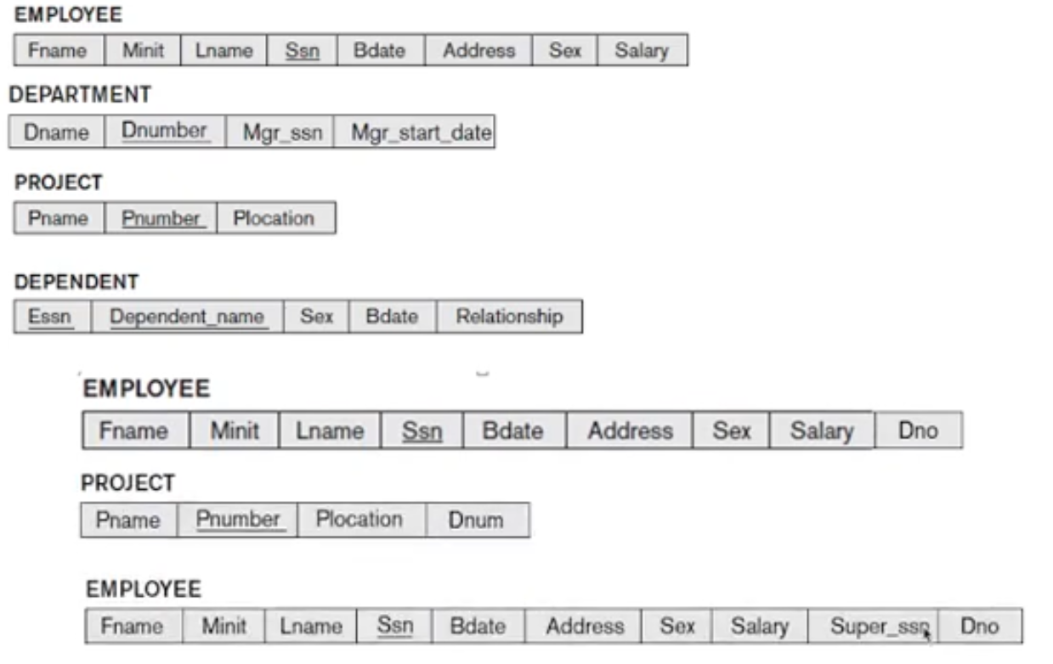
Relational Data Model
Synthesizing ER Diagram to Relational Model
Step 4: Mapping of binary 1:N relationship types
WORKS_FOR, CONTROLS and SUPERVISION

Slide 39
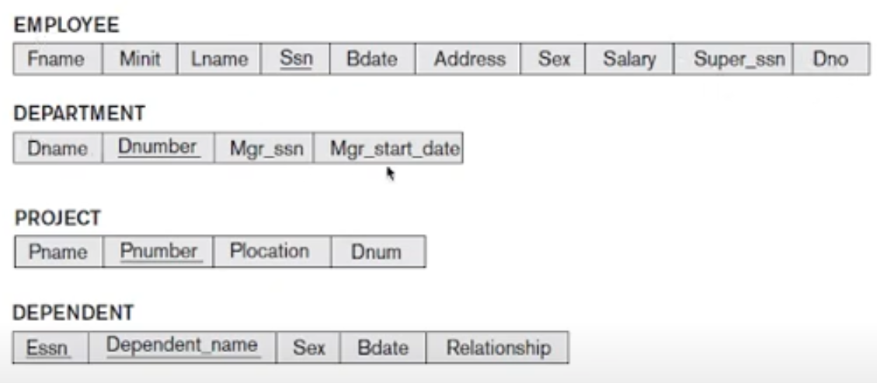
Relational Data Model
Synthesizing ER Diagram to Relational Model
Step 4: Mapping of binary 1:N relationship types
After step 4

Slide 40
Relational Data Model
Synthesizing ER Diagram to Relational Model
Step 5: Mapping of binary M:N relationship types
For each regular binary M:N relationship type R, create a new relation S to represent R
Include as foreign key attributes in S the primary keys of the relations that represent the participating entity types
Their combinations will form the primary key of S
Also include any simple attributes of the M:N relationship type as attribute of S

Slide 41
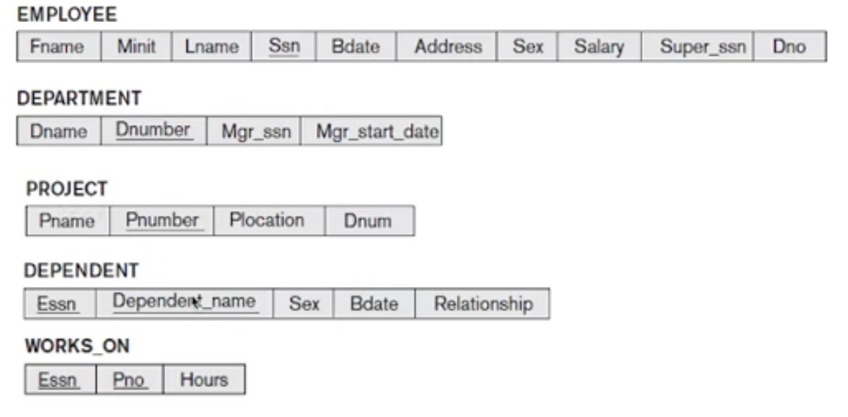
Relational Data Model
Synthesizing ER Diagram to Relational Model
Step 5: Mapping of binary M:N relationship types
After Step 5

Slide 42
Relational Data Model
Synthesizing ER Diagram to Relational Model
Step 6: Mapping of multivalued attributes
For each multivalued attribute A, create a new relation R include an attribute corresponding to A plus the primary key attribute K as a foreign key in R of the relation that represents the entity type of relationship type that has A as an attribute
The primary key of R is the combination of A and K
If the multivalued attribute is composite, we include its simple components

Slide 43
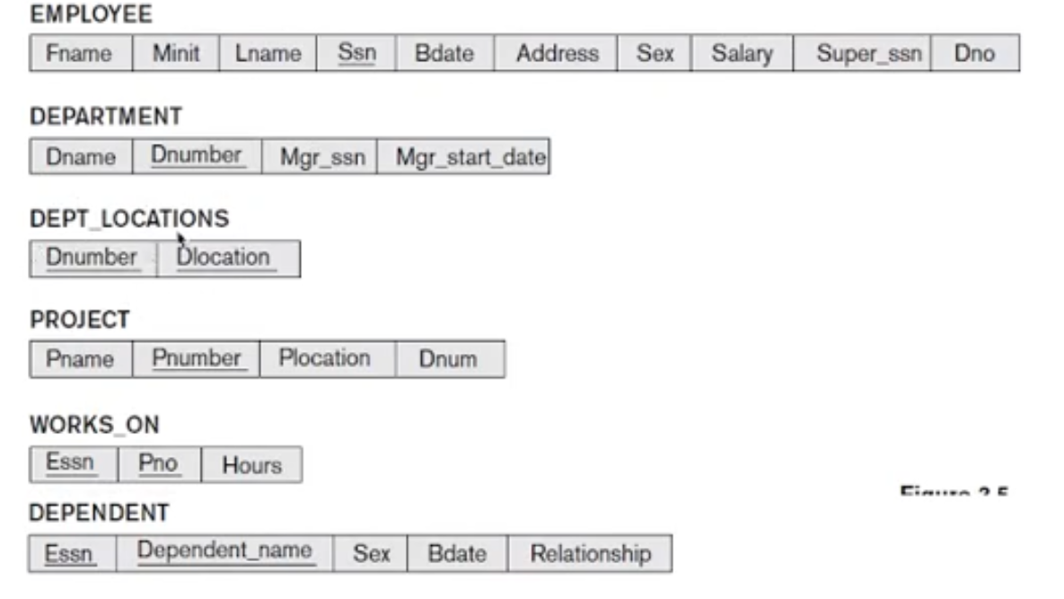
Relational Data Model
Synthesizing ER Diagram to Relational Model
Step 6: Mapping of multivalued attributes
After Step 6

Slide 44
Relational Data Model
Synthesizing ER Diagram to Relational Model
Step 7: Mapping of N-ary relationship types
For each n-ary relationship type R, where n>2, create a new relationship S to represent R
Include as foreign key attributes in S the primary keys of the relations that represent the participating entity types
Also include any simple attributes of the n-ary relationship type as attributes of S

Slide 45
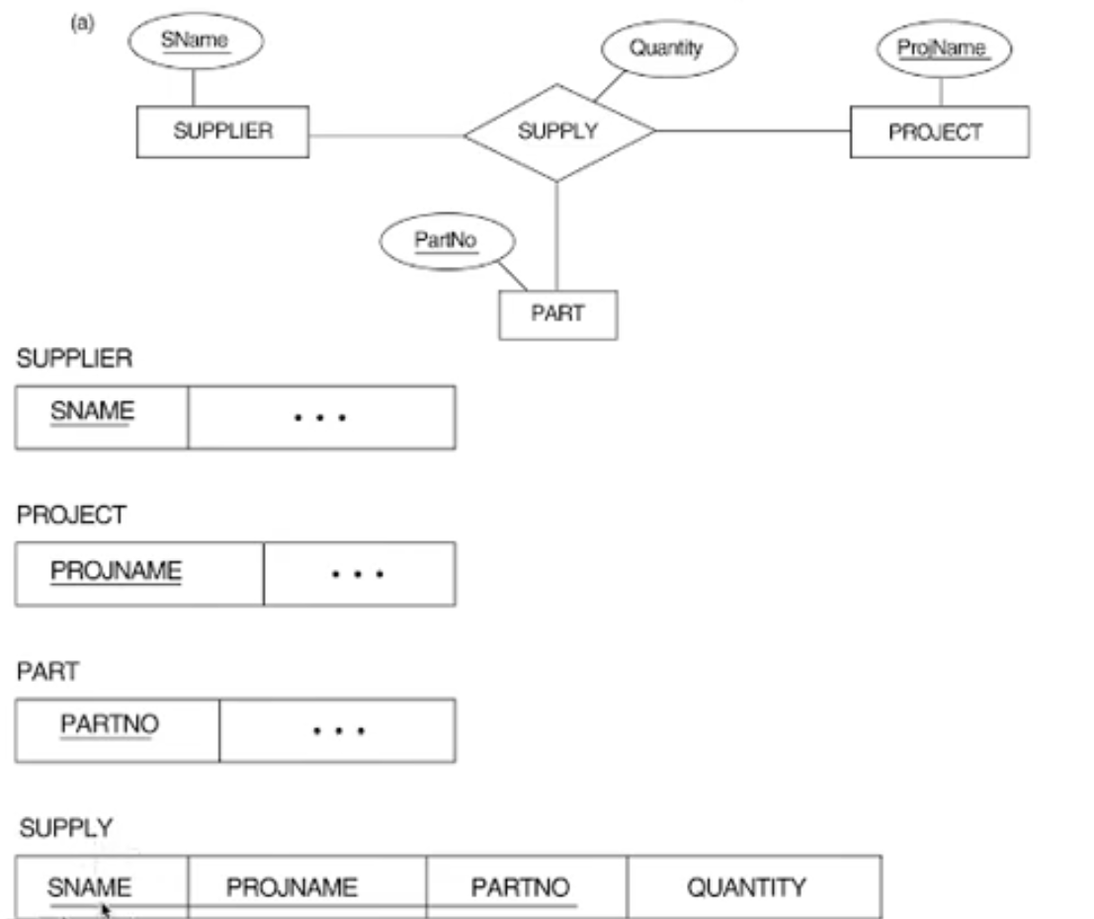
Relational Data Model
Synthesizing ER Diagram to Relational Model
Step 7: Mapping of N-ary relationship types
After Step 7

Slide 46
Relational Algebra
Relational Algebra
Basic set of operations for the relational model is known as the relational algebra
Operations enable a user to specify basic retrieval requests
Result of a retrieval is a new relation
Algebra operations produce a new relations
Sequence of relational algebra operations forms a relational algebra expression
Various types of relational algebra operations includes - Unary relational operations, operations from set theory and binary relational operations

Slide 47
Relational Algebra
Relational Algebra
Provides a formal foundation for relational model operations
Used as a basis for implementing and optimizing queries
Some of its concepts are incorporated into the SQL which is the standard querying language of RDBMS
The core operations and functions in the internal modules of most relational systems are based on relational algebra operations

Slide 48
Relational Algebra
Unary operation - SELECT
SELECT operation is used to select a subset of the tuples from a relation that satisfy a selection condition
A filter that keeps only those tuples that satisfy a qualifying condition
Select operation is denoted by
Where is used to denote the select operator
Selection condition is a Boolean expression specified on the attributes of relation R

Slide 49
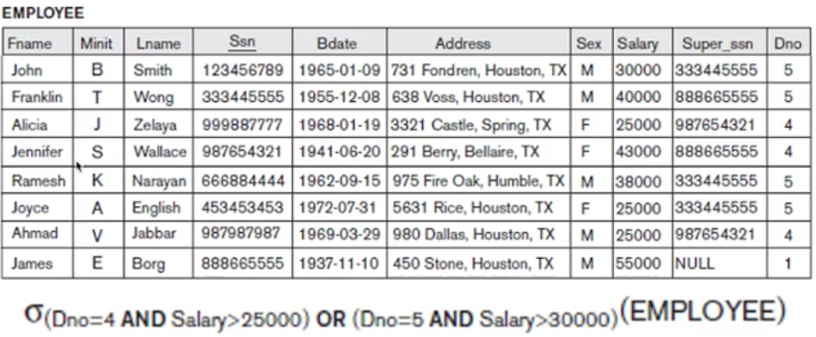
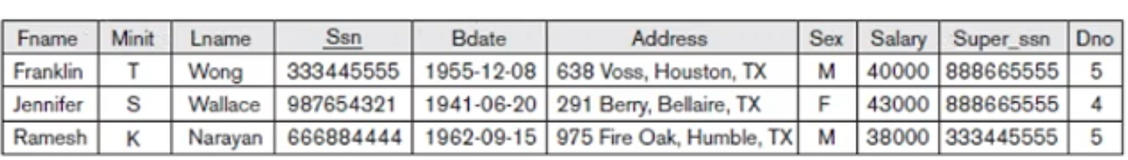
Relational Algebra
Unary operation - SELECT

Slide 50
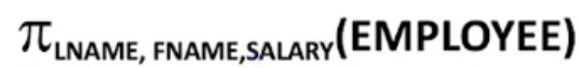
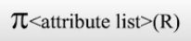
Relational Algebra
Unary operation - PROJECT
PROJECT operation selects certain columns from the table and discards the other columns
Creates a vertical partitioning
To list each employee’s first and last name and salary, the following is used
The general form of the project operation is
Pi is the symbol used to represent the project operation
<attribute list> is the desired list of attributes from the attributes of relation R

Slide 51
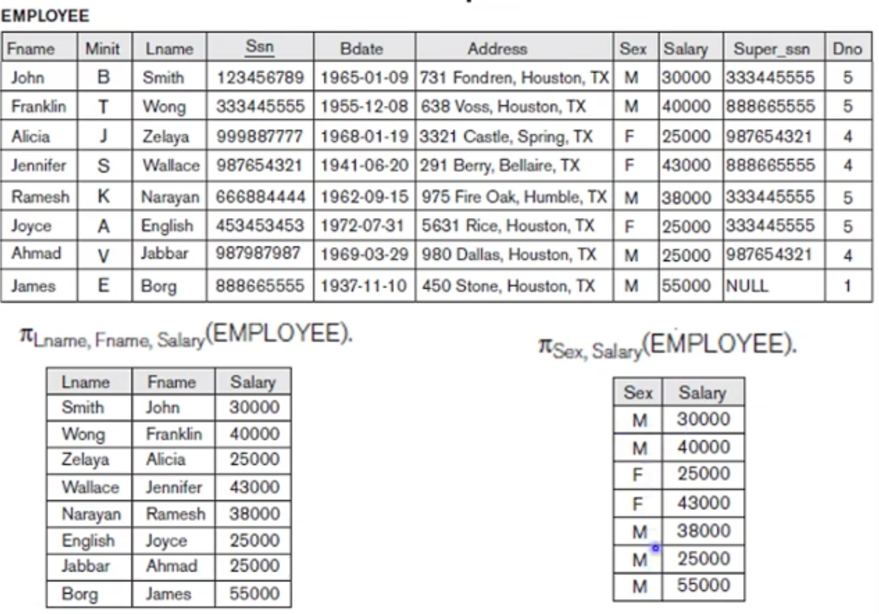
Relational Algebra
Unary operation - PROJECT

Slide 52
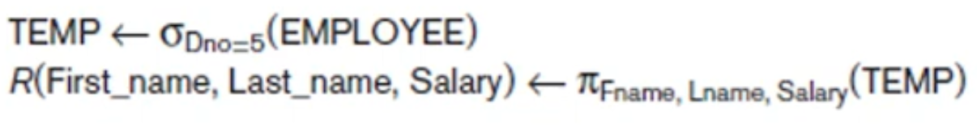
Relational Algebra
Unary operation - RENAME
Apply several relational algebra operations one after the other, and intermediate results are stored in separate relations
If we want to rename the intermediate relation we use the RENAME operator
Rename operator is

Slide 53
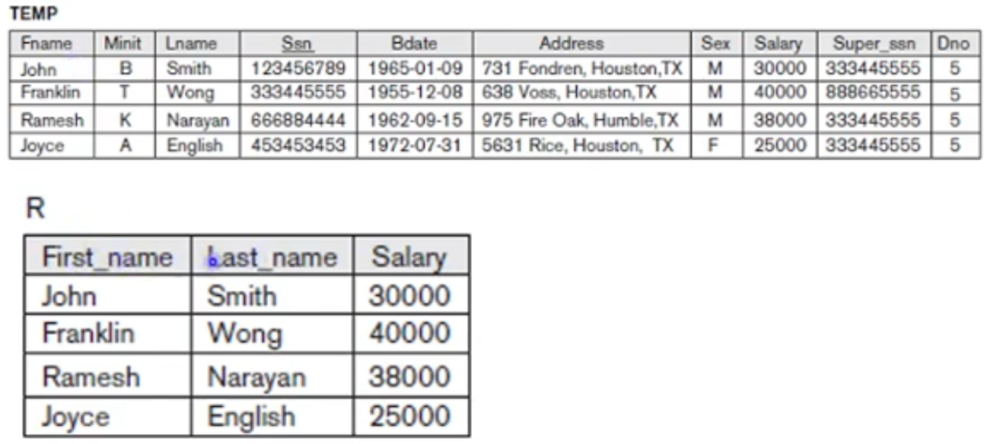
Relational Algebra
Unary operation - RENAME

Slide 54
Relational Algebra
Relational operation from set theory
Basic relational algebraic operation from set theory includes
UNION
INTERSECTION
DIFFERENCE
CARTESIAN PRODUCT
UNION Operation
Denoted by
Results in a relation that includes all tuples that are either in R or in S or in both R and S
Duplicated tuples are eliminated

Slide 55
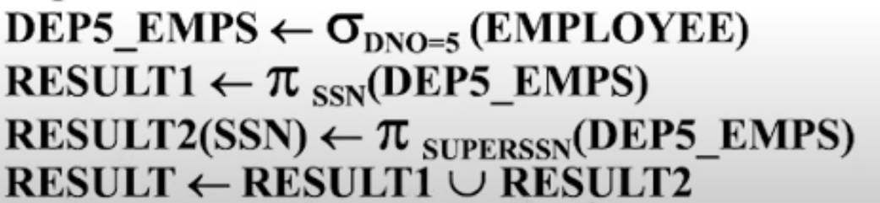
Relational Algebra
Relational operation from set theory
UNION Operation
For example, to retrieve the social security numbers of all employees who either work in department 5 or directly supervise an employee who works in department 5

Slide 56
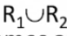
Relational Algebra
Relational operation from set theory
UNION Operation
Type compatibility –
operand relations R₁(A₁, A₂, …. , A_{n}) and R₂(B₁, B₂,…, B_{n}) must have the same number of attributes
The domains of corresponding attributes must be compatible; that is dom(A_{i}) = dom(B_{i}) for I = 1, 2, …., n
The resulting relation for has the same attribute names as the first operand realtion R₁ by convention

Slide 57
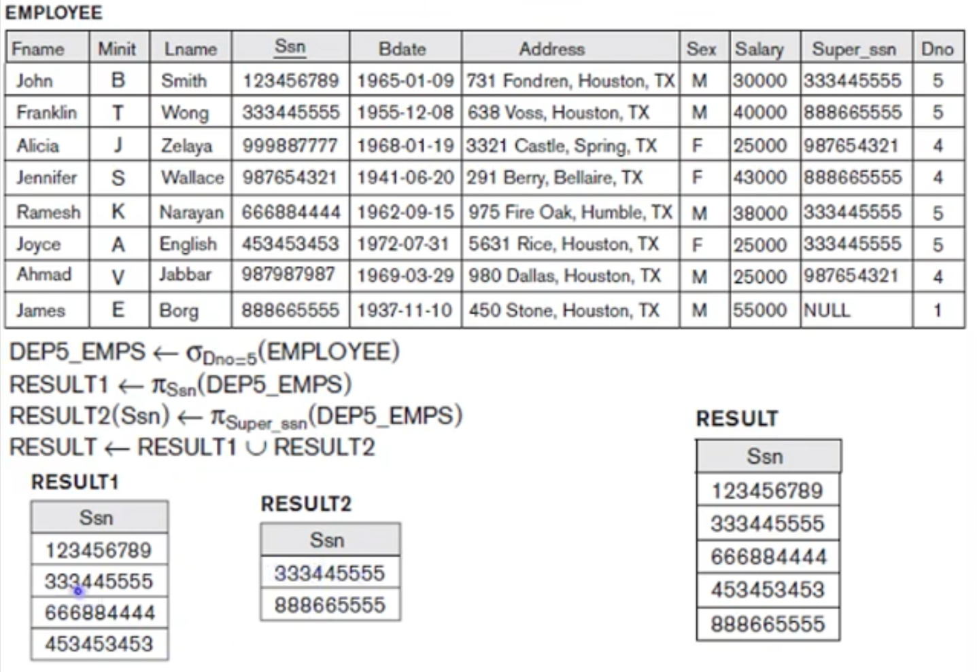
Relational Algebra
Relational operation from set theory
UNION Operation - Examples

Slide 58
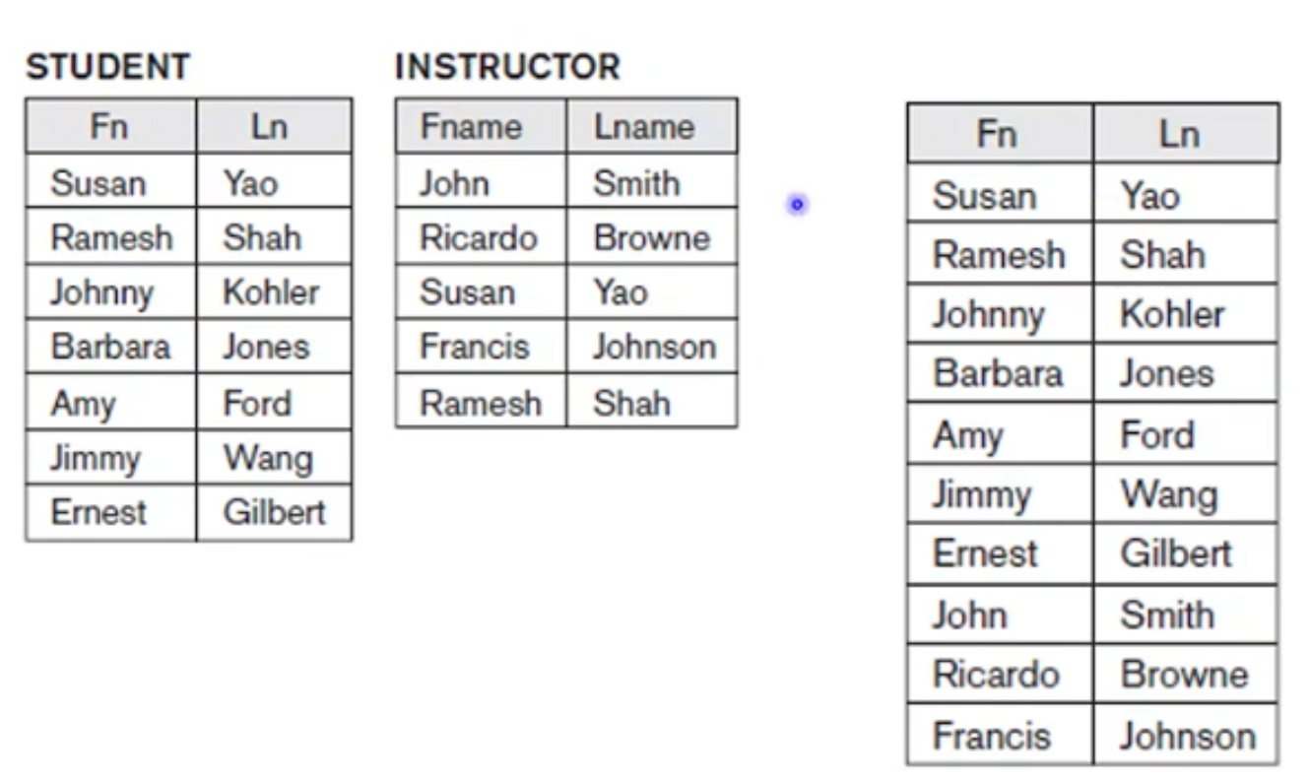
Relational Algebra
Relational operation from set theory
UNION Operation - Examples

Slide 59
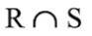
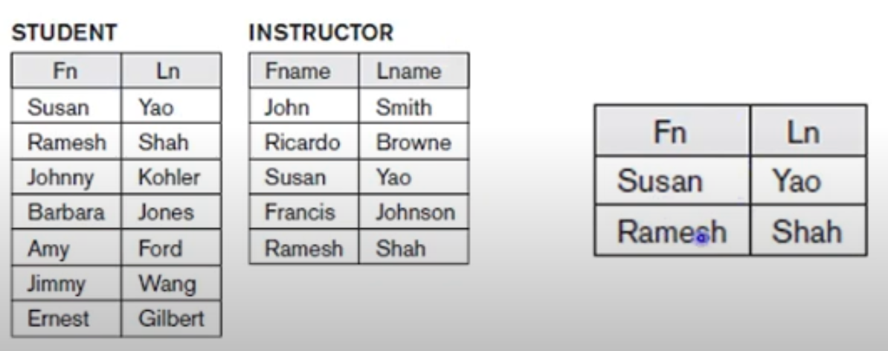
Relational Algebra
Relational operation from set theory
INTERSECTION Operation
Denoted by
Result is a relation that includes all tuples that are in both R and S
Two operands must be “type compatible”

Slide 60
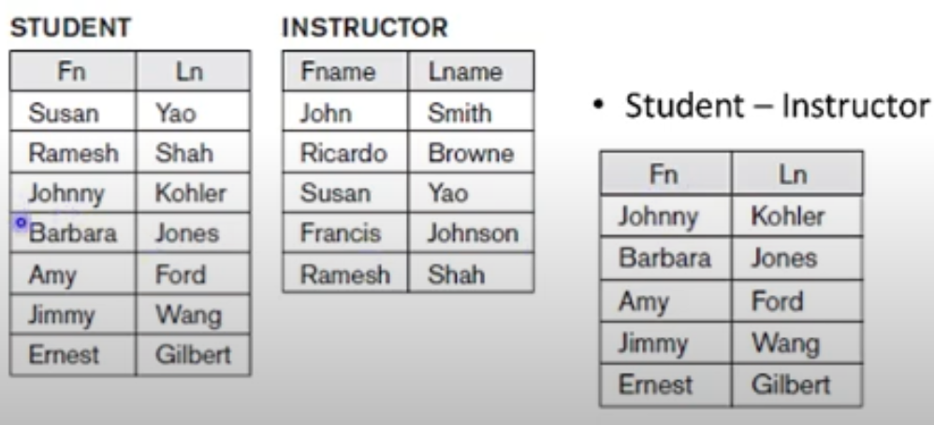
Relational Algebra
Relational operation from set theory
DIFFERENCE Operation
Denoted by R – S
Result is a relation that includes all tuples that are in both R but not in S
Two operands must be “type compatible”

Slide 61
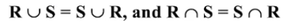
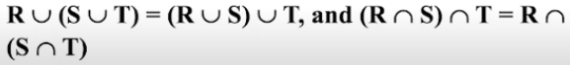
Relational Algebra
Relational operation from set theory
Both union and intersection are commutative
Both union and intersection can be treated as n- ary operations applicable to any number of relations as both are associative operations
Difference operation is not commutative

Slide 62
Relational Algebra
Relational operation from set theory
CARTESIAN PRODUCT operation
Used to combine tuples from two relations in a combinatorial fashion
R(A₁, A₂, …., A_{n}) X S(B₁, B₂, …., B_{m}) is a relation Q with degree n+m attributes
Q(A₁, A₂,…, A_{n}, B₁, B₂, …., B_{m}) in that order
Resulting relation Q has one tuple for each combination of tuples – one from R and one from S
If R has n_{R} tuples and S has n_{S} tuples, then R X S will have n_{R} * n_{S} tuples

Slide 63
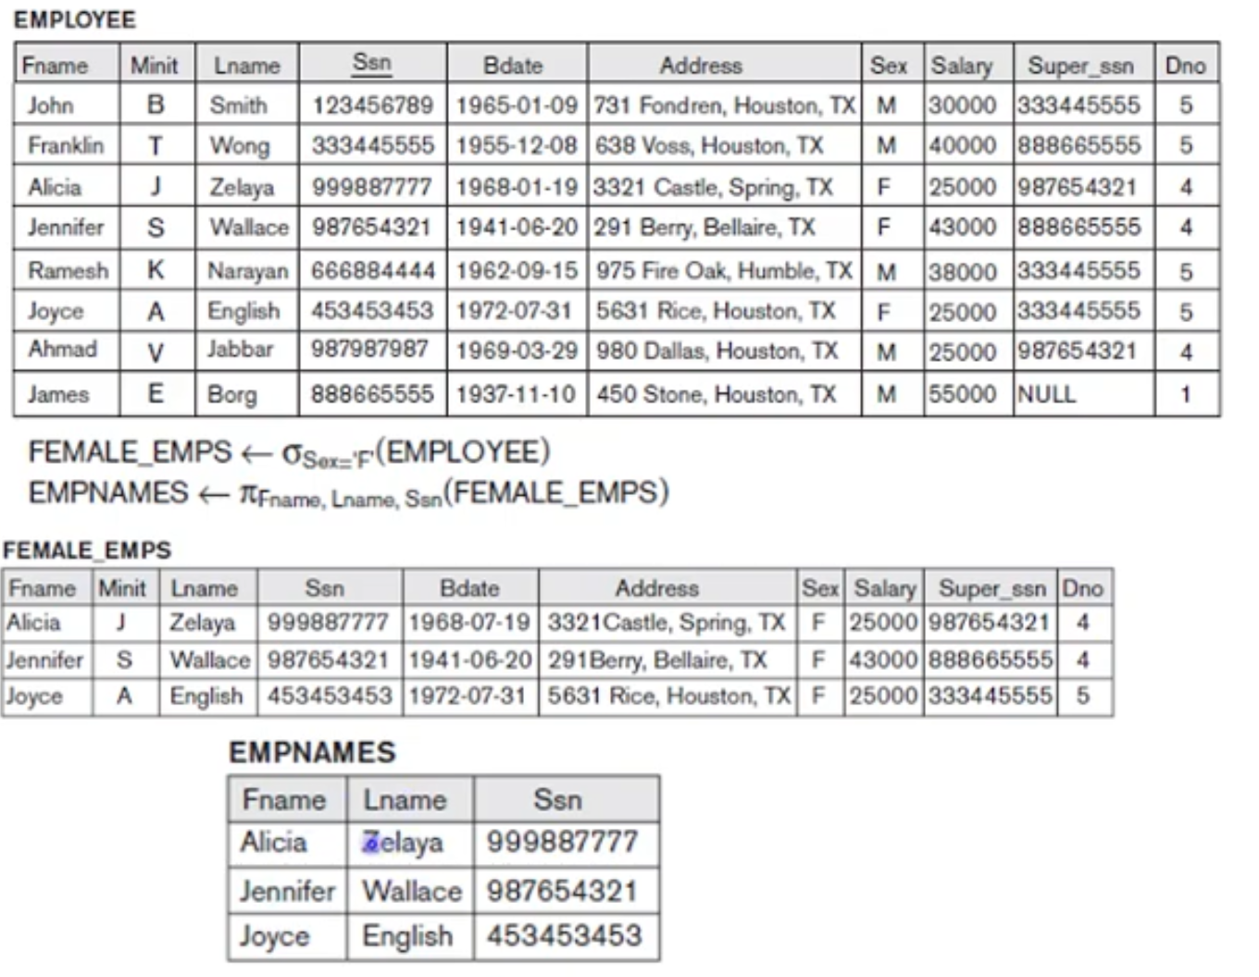
Relational Algebra
Relational operation from set theory
CARTESIAN PRODUCT operation - Example

Slide 64
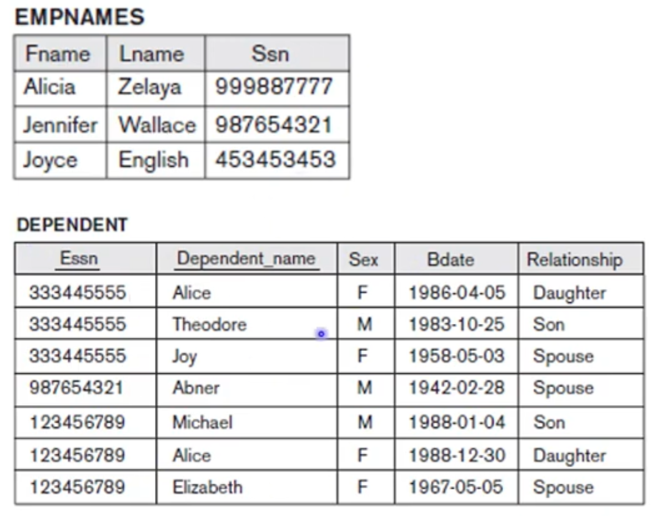
Relational Algebra
Relational operation from set theory
CARTESIAN PRODUCT operation - Example

Slide 65
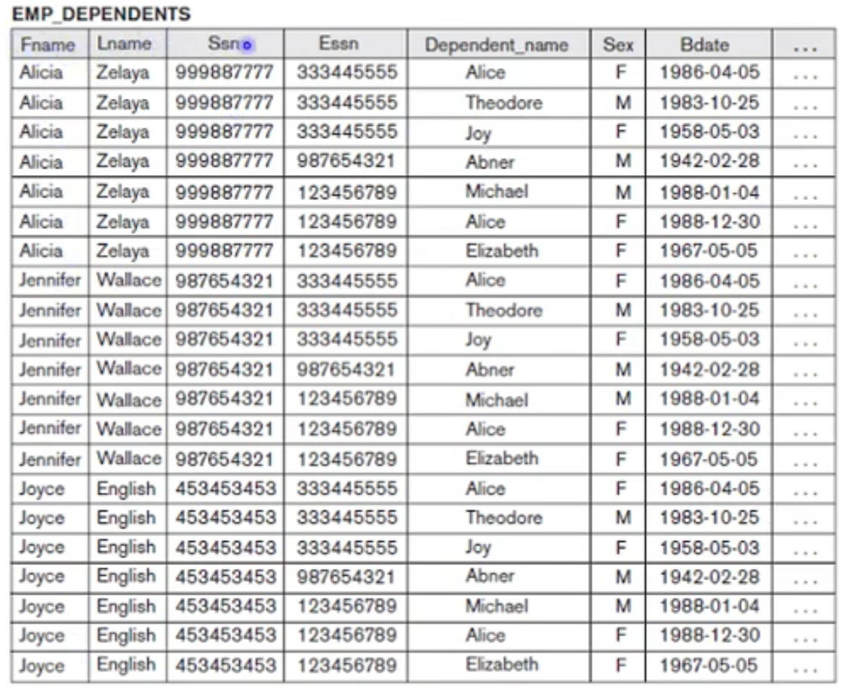
Relational Algebra
Relational operation from set theory
CARTESIAN PRODUCT operation - Example

Slide 66
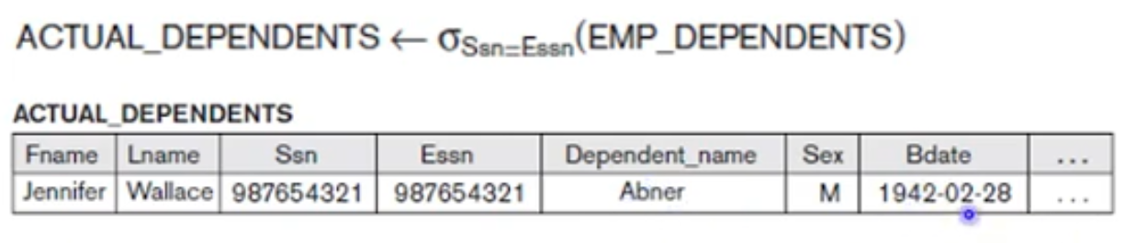
Relational Algebra
Relational operation from set theory
CARTESIAN PRODUCT operation - Example

Slide 67

Relational Algebra
Binary Operations
Binary relational algebraic operations include
JOIN
EQUIJOIN
NATURAL JOIN
DIVISION
JOIN Operations
Sequence of cartesian product followed by select operation is called JOIN
Denoted by
Allows us to process relationships among relations

Slide 68

Relational Algebra
Binary Operations
JOIN Operations
General form of a join operation on two relations R(A₁, A₂,…, A_{n}) and S(B₁, B₂, …, B_{m}) is
Where R and S can be any relations that result from general relational algebra expressions
Example: Retrieve the name of the manager of each department

Slide 69
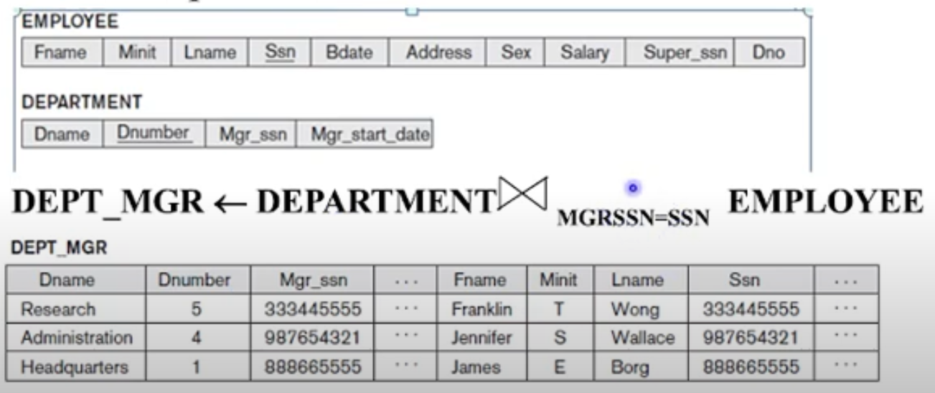
Relational Algebra
Binary Operations
JOIN Operations

Slide 70
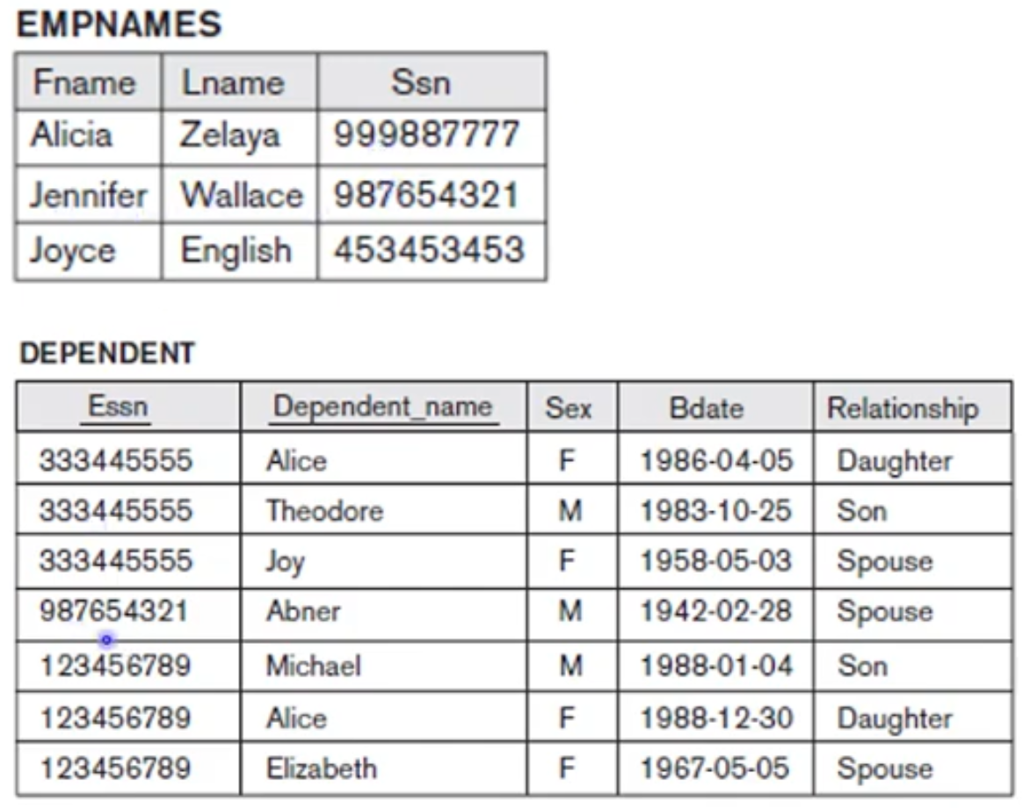
Relational Algebra
Binary Operations
JOIN Operations - Example

Slide 71
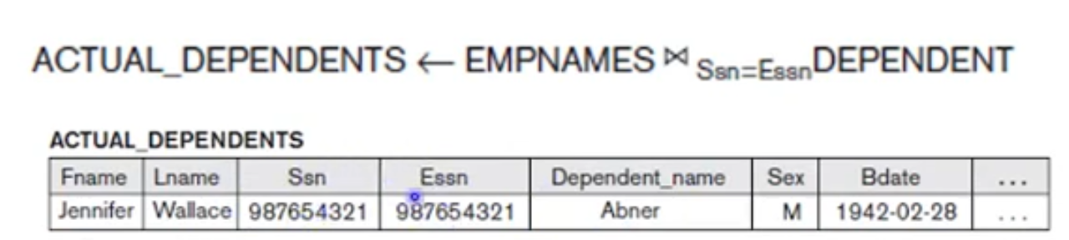
Relational Algebra
Binary Operations
JOIN Operations - Example

Slide 72
Relational Algebra
Binary Operations
Difference between JOIN and CARTESIAN PRODUCT
Results of the JOIN is a relation Q with n + m attributes
Q has one tuple for each combination of tuples – one from R and one from S whenever the combination satisfies the join condition
JOIN – only combinations of tuples satisfying the join condition appear in the result
CASTESIAN PRODUCT – all combinations of tuples are included in the result

Slide 73
Relational Algebra
Binary Operations
JOIN Operation
General JOIN condition is <condition> AND <condition> AND … AND <condition>
Where each <condition> is of the form , Ai is an attribute of R, Bj is an attribute of S, Ai and Bj have the same domain
The theta is one of the comparison operators (=, <, <=, >, >=, !=)
A JOIN operation with such a general join condition is called a THETA JOIN
Tuples whose join attributes are NULL or for which the join condition is FALSE do not appear in the result

Slide 74
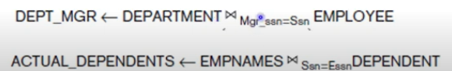
Relational Algebra
Binary Operations
EQUIJOIN Operation
Most common use of EQUIJOIN involves join conditions with equality comparisons only
EQUIJOIN – only comparison operator used is =
Result of an EQUIJOIN is that we always have one or more pairs of attributes that have identical values in every tuples

Slide 75
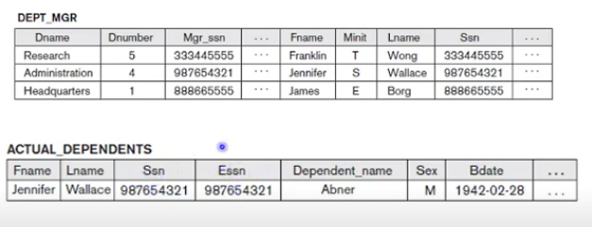
Relational Algebra
Binary Operations
EQUIJOIN Operation

Slide 76
Relational Algebra
Binary Operations
NATURAL JOIN Operation
One of each pair of attributes with identical values is superfluous in EQUIJOIN
NATURAL JOIN is denoted by * was created to get rid of the duplicate attribute in an EQUIJOIN condition
Standard definition of natural join required that the two join attributes or each pair of corresponding join attributes have the same name in both relations
If this is not the case, a renaming operation is applied first

Slide 77
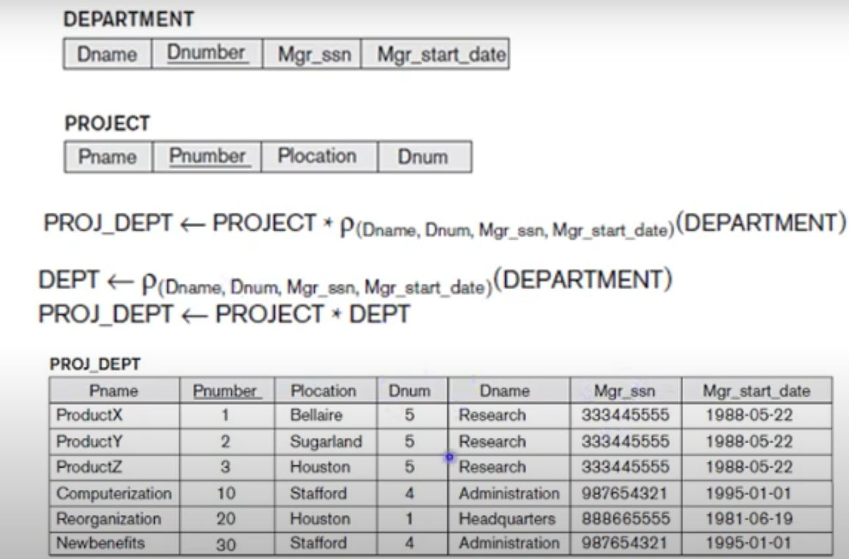
Relational Algebra
Binary Operations
NATURAL JOIN Operation

Slide 78
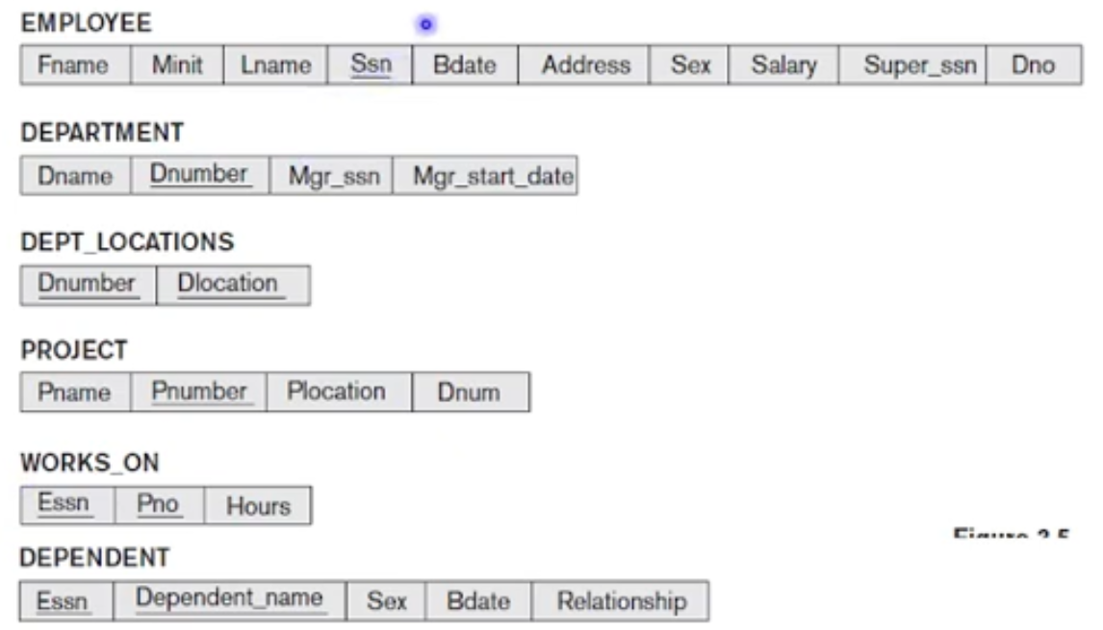
Relational Algebra
Binary Operations
DIVISION Operation
Denoted by
Retrieve the names of employees who work on all the projects that ‘John Smith’ works on

Slide 79
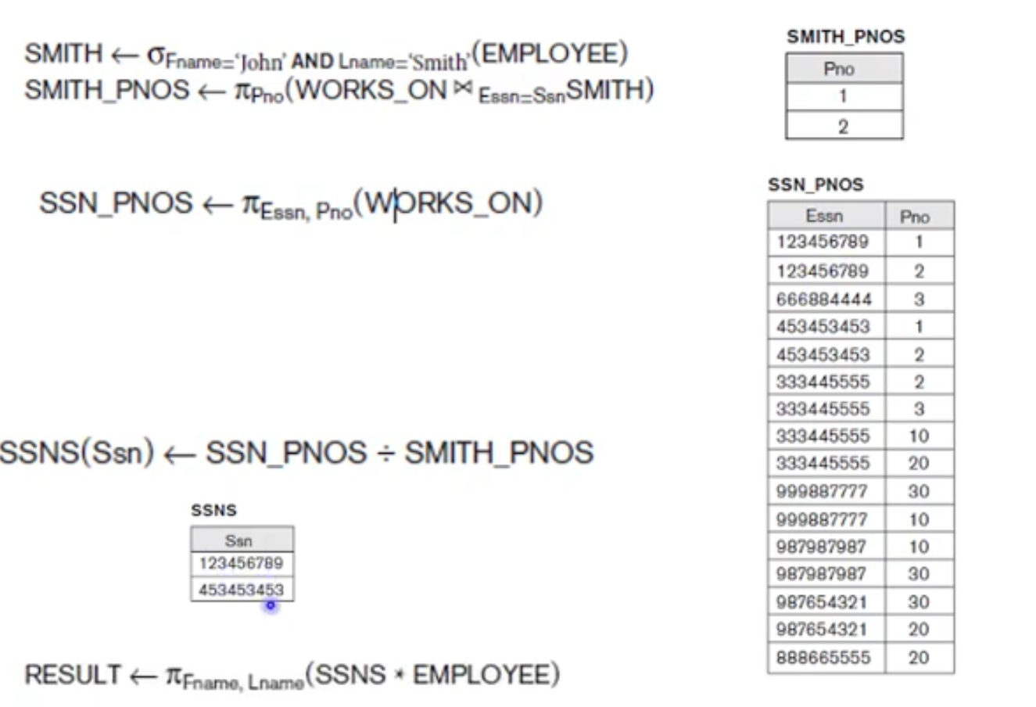
Relational Algebra
Binary Operations
DIVISION Operation

Slide 80
Structured Query Language(SQL)
Structured Query Language(SQL)
SQL is Structured Query Language
It is a computer language for storing, manipulating and retrieving data stored in a relational database
SQL is the standard language for Relational Database System
All the Relational Database Management Systems (RDMS) like MySQL, MS Access, Oracle, Sybase, Informix, Postgres and SQL Server use SQL as their standard database language
SQL is one of the most widely used query language over the databases

Slide 81
Structured Query Language(SQL)
Structured Query Language(SQL) - Features
Allows users to access data in the relational database management systems
Allows users to describe the data
Allows users to define the data in a database and manipulate that data
Allows to embed within other languages using SQL modules, libraries & pre-compilers
Allows users to create and drop databases and tables
Allows users to create view, stored procedure, functions in a database
Allows users to set permissions on tables, procedures and views

Slide 82
Structured Query Language(SQL)
Structured Query Language(SQL) - Databases
MySQL is an open source SQL database, which is developed by a Swedish company – MySQL AB
MySQL is supporting many different platforms including Microsoft Windows, the major Linux distributions, UNIX, and Mac OS X
MySQL has free and paid versions, depending on its usage (non-commercial/commercial) and features
MySQL comes with a very fast, multi-threaded, multi-user and robust SQL database server
MS SQL Server is a Relational Database Management System developed by Microsoft Inc
Its primary query languages are −T-SQL, ANSI SQL

Slide 83
Structured Query Language(SQL)
Structured Query Language(SQL) - Databases
Oracle is a very large multi-user based database management system
Oracle is a relational database management system developed by 'Oracle Corporation'
Oracle works to efficiently manage its resources, a database of information among the multiple clients requesting and sending data in the network
MS Access is one of the most popular Microsoft products
Microsoft Access is an entry-level database management software
MS Access database is not only inexpensive but also a powerful database for small-scale projects

Slide 84
Structured Query Language(SQL)
Structured Query Language(SQL) – Data types
SQL Data Type is an attribute that specifies the type of data of any object
Each column, variable and expression has a related data type in SQL
We can use these data types while creating our tables
We can choose a data type for a table column based on our requirement
SQL Server offers six categories of data types for your use which are listed below:
Exact Numeric Data Types
Approximate Numeric Data Types
Date and Time Data Types
Character Strings Data Types
Unicode Character Strings Data Types
Binary Data Types
Misc Data Types

Slide 85
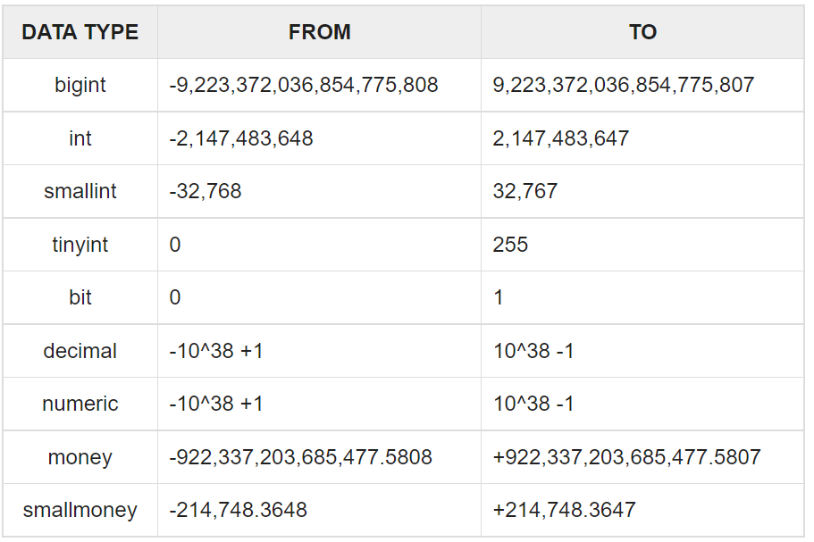
Structured Query Language(SQL)
Structured Query Language(SQL) – Data types
Exact Numeric Data types

Slide 86
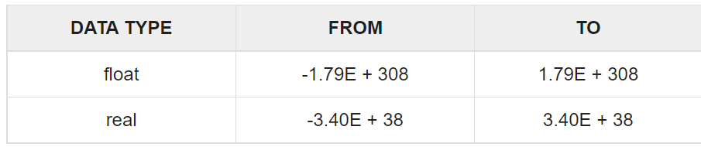
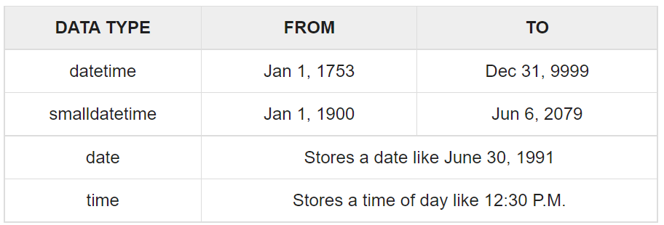
Structured Query Language(SQL)
Structured Query Language(SQL) – Data types
Approximate Numeric Data Types
Date and Time Data Types

Slide 87

Structured Query Language(SQL)
Structured Query Language(SQL) – Data types
Character Strings Data Types

Slide 88

Structured Query Language(SQL)
Structured Query Language(SQL) – Data types
Unicode Character Strings Data Types

Slide 89

Structured Query Language(SQL)
Structured Query Language(SQL) – Data types
Binary Data Types

Slide 90

Structured Query Language(SQL)
Structured Query Language(SQL) – Data types
Misc Data Types

Slide 91

Structured Query Language(SQL)
Structured Query Language(SQL) – Data types
Misc Data Types

Slide 92

Structured Query Language(SQL)
Structured Query Language(SQL) – Operators
SQL contains the following operators:
Arithmetic operators
Comparison operators
Logical operators
Operators used to negate conditions
Arithmetic Operators
Assume 'variable a' holds 10 and 'variable b' holds 20, then −

Slide 93

Structured Query Language(SQL)
Structured Query Language(SQL) – Operators
SQL Comparison Operators
Assume 'variable a' holds 10 and 'variable b' holds 20, then −

Slide 94

Structured Query Language(SQL)
Structured Query Language(SQL) – Operators
SQL Comparison Operators

Slide 95

Structured Query Language(SQL)
Structured Query Language(SQL) – Operators
SQL Logical Operators

Slide 96

Structured Query Language(SQL)
Structured Query Language(SQL) – Operators
SQL Logical Operators

Slide 97

Structured Query Language(SQL)
Structured Query Language(SQL) – Operators
SQL Logical Operators

Slide 98
Structured Query Language(SQL)
SQL Commands
The standard SQL commands to interact with relational databases are CREATE, SELECT, INSERT, UPDATE, DELETE and DROP
These commands can be classified into the following groups based on their nature as:
Data Definition Language (DDL) – CREATE, ALTER, DROP
Data Manipulation Language (DML) – SELECT, INSERT, UPDATE, DELETE
Data Control Language (DCL) – GRANT, REVOKE

Slide 99
Structured Query Language(SQL)
SQL Commands – Data Definition Language (DDL) Commands
DDL(Data Definition Language) : DDL or Data Definition Language actually consists of the SQL commands that can be used to define the database schema
It simply deals with descriptions of the database schema and is used to create and modify the structure of database objects in the database
Examples of DDL commands:
CREATE – is used to create the database or its objects (like table, index, function, views, store procedure and triggers)
DROP – is used to delete objects from the database
ALTER-is used to alter the structure of the database
TRUNCATE–is used to remove all records from a table, including all spaces allocated for the records are removed
COMMENT –is used to add comments to the data dictionary
RENAME –is used to rename an object existing in the database

Slide 100
Structured Query Language(SQL)
SQL Commands – CREATE Command
The SQL CREATE DATABASE statement is used to create a new SQL database
The basic syntax of this CREATE DATABASE statement is as follows −
CREATE DATABASE DatabaseName;
Always the database name should be unique within the RDBMS
For example:
If we want to create a new database <testDB>, then the CREATE DATABASE statement would be as shown below −
SQL> CREATE DATABASE testDB;

Slide 101
Structured Query Language(SQL)
SQL Commands – CREATE Command
The SQL CREATE TABLE statement is used to create a new table
The basic syntax of the CREATE TABLE statement is as follows −
CREATE TABLE table_name(
column1 datatype,
column2 datatype,
column3 datatype,
.....
columnN datatype,
PRIMARY KEY( one or more columns )
);

Slide 102
Structured Query Language(SQL)
SQL Commands – CREATE Command
For example:
Create a CUSTOMERS table with an ID as a primary key and NOT NULL are the constraints showing that these fields cannot be NULL while creating records in this table −
CREATE TABLE CUSTOMERS(
ID INT NOT NULL,
NAME VARCHAR (20) NOT NULL,
AGE INT NOT NULL,
ADDRESS CHAR (25) ,
SALARY DECIMAL (18, 2),
PRIMARY KEY (ID));

Slide 103

Structured Query Language(SQL)
SQL Commands – CREATE Command
We can verify if our table has been created successfully by looking at the message displayed by the SQL server, otherwise you can use the DESC command as follows

Slide 104
Structured Query Language(SQL)
SQL Commands – DROP Command
The SQL DROP DATABASE statement is used to drop an existing database in SQL schema
The basic syntax of DROP DATABASE statement is as follows −
DROP DATABASE DatabaseName;
Always the database name should be unique within the RDBMS
For example, if we want to delete an existing database <testDB>, then the DROP DATABASE statement would be as shown below −
DROP DATABASE testDB;
NOTE − Be careful before using this operation because by deleting an existing database would result in loss of complete information stored in the database

Slide 105
Structured Query Language(SQL)
SQL Commands – DROP Command
The SQL DROP TABLE statement is used to remove a table definition and all the data, indexes, triggers, constraints and permission specifications for that table
The basic syntax of this DROP TABLE statement is as follows −
DROP TABLE table_name;
For example, if we want to drop the CUSTOMERS table from the database, we use the query
DROP TABLE CUSTOMERS;

Slide 106
Structured Query Language(SQL)
SQL Commands – ALTER Command
The ALTER TABLE statement is used to add, delete, or modify columns in an existing table
The ALTER TABLE statement is also used to add and drop various constraints on an existing table
To add a new column to table we use the query:
ALTER TABLE table_name
ADD column_name datatype;
For example:
ALTER TABLE CUSTOMERS
ADD Email varchar(255);

Slide 107
Structured Query Language(SQL)
SQL Commands – ALTER Command
To delete a column in a table, we use the query:
ALTER TABLE table_name
DROP COLUMN column_name;
For example:
ALTER TABLE Customers
DROP COLUMN Email;

Slide 108
Structured Query Language(SQL)
SQL Commands – INSERT Command
The SQL INSERT INTO Statement is used to add new rows of data to a table in the database
There are two basic syntaxes of the INSERT INTO statement which are shown below:
INSERT INTO TABLE_NAME (column1, column2, column3,...columnN)
VALUES (value1, value2, value3,...valueN);
Here, column1, column2, column3,...columnN are the names of the columns in the table into which you want to insert the data
We may not need to specify the column(s) name in the SQL query if we are adding values for all the columns of the table
But make sure the order of the values is in the same order as the columns in the table

Slide 109
Structured Query Language(SQL)
SQL Commands – INSERT Command
The other way of using INSERT TO is as follows:
INSERT INTO TABLE_NAME VALUES (value1,value2,value3,...valueN);
The following statements would create six records in the CUSTOMERS table.
INSERT INTO CUSTOMERS (ID,NAME,AGE,ADDRESS,SALARY)
VALUES (1, 'Ramesh', 32, 'Ahmedabad', 2000.00 );
INSERT INTO CUSTOMERS (ID,NAME,AGE,ADDRESS,SALARY)
VALUES (2, 'Khilan', 25, 'Delhi', 1500.00 );
INSERT INTO CUSTOMERS (ID,NAME,AGE,ADDRESS,SALARY)
VALUES (3, 'kaushik', 23, 'Kota', 2000.00 );
INSERT INTO CUSTOMERS (ID,NAME,AGE,ADDRESS,SALARY)
VALUES (4, 'Chaitali', 25, 'Mumbai', 6500.00 );
INSERT INTO CUSTOMERS (ID,NAME,AGE,ADDRESS,SALARY)
VALUES (5, 'Hardik', 27, 'Bhopal', 8500.00 );
INSERT INTO CUSTOMERS (ID,NAME,AGE,ADDRESS,SALARY)
VALUES (6, 'Komal', 22, 'MP', 4500.00 );

Slide 110

Structured Query Language(SQL)
SQL Commands – INSERT Command
We can create a record in the CUSTOMERS table by using the second syntax as shown below:
INSERT INTO CUSTOMERS
VALUES (7, 'Muffy', 24, 'Indore', 10000.00 );
All the above statements would produce the following records in the CUSTOMERS table as shown below

Slide 111
Structured Query Language(SQL)
SQL Commands – SELECT Command
The SQL SELECT statement is used to fetch the data from a database table which returns this data in the form of a result table
These result tables are called result-sets
The basic syntax of the SELECT statement is as follows −
SELECT column1, column2, columnN FROM table_name;
Here, column1, column2... are the fields of a table whose values we want to fetch
If we want to fetch all the fields available in the field, then we can use the following syntax
SELECT * FROM table_name;

Slide 112

Structured Query Language(SQL)
SQL Commands – SELECT Command
Consider the CUSTOMERS table having the following records
The following code is an example, which would fetch the ID, Name and Salary fields of the customers available in CUSTOMERS table
SELECT ID, NAME, SALARY FROM CUSTOMERS;

Slide 113

Structured Query Language(SQL)
SQL Commands – SELECT Command
This will produce the following results as:
If we want to fetch all the fields of the CUSTOMERS table, then we should use the following query
SELECT * FROM CUSTOMERS;

Slide 114

Structured Query Language(SQL)
SQL Commands – SELECT Command
This will produce the following results as:

Slide 115
Structured Query Language(SQL)
SQL Commands – SELECT Command
The SQL WHERE clause is used to specify a condition while fetching the data from a single table or by joining with multiple tables
If the given condition is satisfied, then only it returns a specific value from the table.
We should use the WHERE clause to filter the records and fetching only the necessary records
The basic syntax of the SELECT statement with the WHERE clause is as shown below
SELECT column1, column2, columnN
FROM table_name
WHERE [condition]

Slide 116
Structured Query Language(SQL)
SQL Commands – SELECT Command
The SQL WHERE clause is used to specify a condition while fetching the data from a single table or by joining with multiple tables
If the given condition is satisfied, then only it returns a specific value from the table.
We should use the WHERE clause to filter the records and fetching only the necessary records
The basic syntax of the SELECT statement with the WHERE clause is as shown below
SELECT column1, column2, columnN
FROM table_name
WHERE [condition]

Slide 117

Structured Query Language(SQL)
SQL Commands – SELECT Command
Consider the example:
The following code is an example which would fetch the ID, Name and Salary fields from the CUSTOMERS table, where the salary is greater than 2000 −
SQL> SELECT ID, NAME, SALARY
FROM CUSTOMERS
WHERE SALARY > 2000;

Slide 118

Structured Query Language(SQL)
SQL Commands – SELECT Command
This would produce the following result −
The following query is an example, which would fetch the ID, Name and Salary fields from the CUSTOMERS table for a customer with the name Hardik
Here, it is important to note that all the strings should be given inside single quotes (‘’), whereas, numeric values should be given without any quote as in the above example
SQL> SELECT ID, NAME, SALARY
FROM CUSTOMERS
WHERE NAME = 'Hardik';

Slide 119

Structured Query Language(SQL)
SQL Commands – SELECT Command
This would produce the following result −
The WHERE clause is not only used in the SELECT statement, but it is also used in the UPDATE, DELETE statement, etc
The SQL AND & OR operators are used to combine multiple conditions to narrow data in an SQL statement
These two operators are called as the conjunctive operators
These operators provide a means to make multiple comparisons with different operators in the same SQL statement

Slide 120
Structured Query Language(SQL)
SQL Commands – SELECT Command
The AND operator allows the existence of multiple conditions in an SQL statement's WHERE clause
The basic syntax of the AND operator with a WHERE clause is as follows −
SELECT column1, column2, columnN
FROM table_name
WHERE [condition1] AND [condition2]...AND [conditionN];
Following is an example, which would fetch the ID, Name and Salary fields from the CUSTOMERS table, where the salary is greater than 2000 and the age is less than 25 years −
SQL> SELECT ID, NAME, SALARY
FROM CUSTOMERS
WHERE SALARY > 2000 AND age < 25;

Slide 121

Structured Query Language(SQL)
SQL Commands – SELECT Command
This would produce the following result −
The OR operator is used to combine multiple conditions in an SQL statement's WHERE clause
The basic syntax of the OR operator with a WHERE clause is as follows −
SELECT column1, column2, columnN
FROM table_name
WHERE [condition1] OR [condition2]...OR [conditionN]
Only any ONE of the conditions separated by the OR must be TRUE

Slide 122

Structured Query Language(SQL)
SQL Commands – SELECT Command
The following query would fetch the ID, Name and Salary fields from the CUSTOMERS table, where the salary is greater than 2000 OR the age is less than 25 years
SQL> SELECT ID, NAME, SALARY
FROM CUSTOMERS
WHERE SALARY > 2000 OR age < 25;
This would produce the following result −

Slide 123
Structured Query Language(SQL)
SQL Commands – SELECT Command
The SQL LIKE clause is used to compare a value to similar values using wildcard operators
There are two wildcards used in conjunction with the LIKE operator
The percent sign (%)
The underscore (_)
The percent sign represents zero, one or multiple characters
The underscore represents a single number or character
These symbols can be used in combinations
The basic syntax of % and _ is as follows −
SELECT FROM table_name
WHERE column LIKE 'XXXX%’
or
SELECT FROM table_name
WHERE column LIKE '%XXXX%'

Slide 124
Structured Query Language(SQL)
SQL Commands – SELECT Command
or
SELECT FROM table_name
WHERE column LIKE 'XXXX_’
or
SELECT FROM table_name
WHERE column LIKE '_XXXX’
or
SELECT FROM table_name
WHERE column LIKE '_XXXX_’
We can combine N number of conditions using AND or OR operators
Here, XXXX could be any numeric or string value

Slide 125

Structured Query Language(SQL)
SQL Commands – SELECT Command
For example:

Slide 126

Structured Query Language(SQL)
SQL Commands – SELECT Command
For example:

Slide 127

Structured Query Language(SQL)
SQL Commands – SELECT Command
Following is an example, which would display all the records from the CUSTOMERS table, where the SALARY starts with 200
SQL> SELECT * FROM CUSTOMERS
WHERE SALARY LIKE '200%';
This would produce the following result −

Slide 128
Structured Query Language(SQL)
SQL Commands – SELECT Command
The SQL ORDER BY clause is used to sort the data in ascending or descending order, based on one or more columns
Some databases sort the query results in an ascending order by default
The basic syntax of the ORDER BY clause is as follows −
SELECT column-list
FROM table_name
[WHERE condition]
[ORDER BY column1, column2, .. columnN] [ASC | DESC];

Slide 129

Structured Query Language(SQL)
SQL Commands – SELECT Command
Consider the CUSTOMERS table having the following records −
The following code block has an example, which would sort the result in an ascending order by the NAME and the SALARY −
SQL> SELECT * FROM CUSTOMERS
ORDER BY NAME, SALARY;

Slide 130

Structured Query Language(SQL)
SQL Commands – SELECT Command
This would produce the following result −
The following code block has an example, which would sort the result in an ascending order by the NAME −
SQL> SELECT * FROM CUSTOMERS
ORDER BY NAME ASC;

Slide 131

Structured Query Language(SQL)
SQL Commands – SELECT Command
This would produce the following result −
The following code block has an example, which would sort the result in the descending order by NAME
SQL> SELECT * FROM CUSTOMERS
ORDER BY NAME DESC;

Slide 132

Structured Query Language(SQL)
SQL Commands – SELECT Command
This would produce the following result −

Slide 133
Structured Query Language(SQL)
SQL Commands – UPDATE Command
The SQL UPDATE Query is used to modify the existing records in a table
We can use the WHERE clause with the UPDATE query to update the selected rows, otherwise all the rows would be affected
The basic syntax of the UPDATE query with a WHERE clause is as follows −
UPDATE table_name
SET column1 = value1, column2 = value2...., columnN = valueN
WHERE [condition];

Slide 134

Structured Query Language(SQL)
SQL Commands – UPDATE Command
Consider the CUSTOMERS table having the following records −
The following query will update the ADDRESS for a customer whose ID number is 6 in the table.
SQL> UPDATE CUSTOMERS
SET ADDRESS = 'Pune’
WHERE ID = 6;

Slide 135

Structured Query Language(SQL)
SQL Commands – UPDATE Command
Now, the CUSTOMERS table would have the following records −
If we want to modify all the ADDRESS and the SALARY column values in the CUSTOMERS table, we do not need to use the WHERE clause as the UPDATE query would be enough as shown in the following code block
SQL> UPDATE CUSTOMERS
SET ADDRESS = 'Pune', SALARY = 1000.00;

Slide 136

Structured Query Language(SQL)
SQL Commands – UPDATE Command
Now, CUSTOMERS table would have the following records −

Slide 137
Structured Query Language(SQL)
SQL Commands – DELETE Command
The SQL DELETE Query is used to delete the existing records from a table
You can use the WHERE clause with a DELETE query to delete the selected rows, otherwise all the records would be deleted
The basic syntax of the DELETE query with the WHERE clause is as follows
DELETE FROM table_name
WHERE [condition];

Slide 138

Structured Query Language(SQL)
SQL Commands – DELETE Command
Consider the CUSTOMERS table having the following records −
The following code has a query, which will DELETE a customer, whose ID is 6
SQL> DELETE FROM CUSTOMERS
WHERE ID = 6;

Slide 139

Structured Query Language(SQL)
SQL Commands – DELETE Command
Now, the CUSTOMERS table would have the following records
If we want to DELETE all the records from the CUSTOMERS table, we do not need to use the WHERE clause and the DELETE query would be as follows :
SQL> DELETE FROM CUSTOMERS;
Now, the CUSTOMERS table would not have any record

